Slide 1




Training on Arduino

Slide 2
Arduino
IDE INSTALLATION

Slide 3
Arduino
IDE OVERVIEW
IDE INSTALLATION

Slide 4
Arduino
HELLO WORLD
IDE OVERVIEW

Slide 5
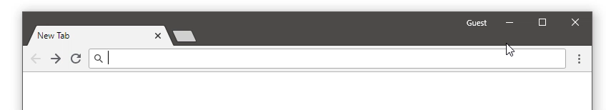
Arduino IDE INSTALLATION
Type Arduino in search box

Slide 6
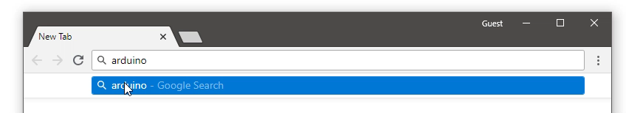
Select Search from option

Slide 7
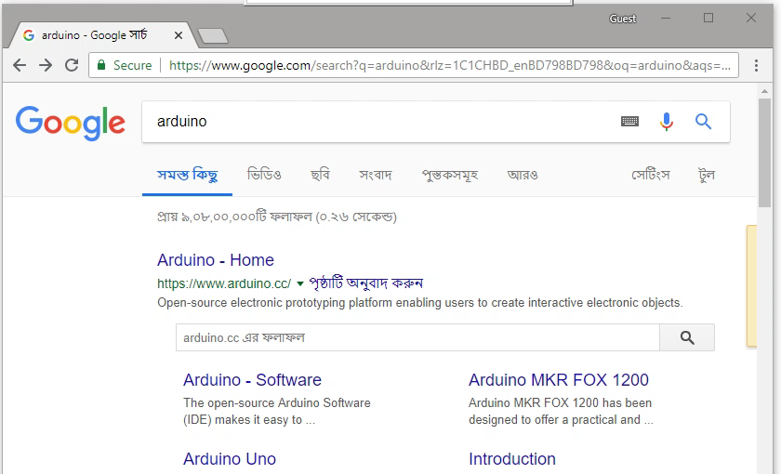
Select Arduino-Software from search result

Slide 8
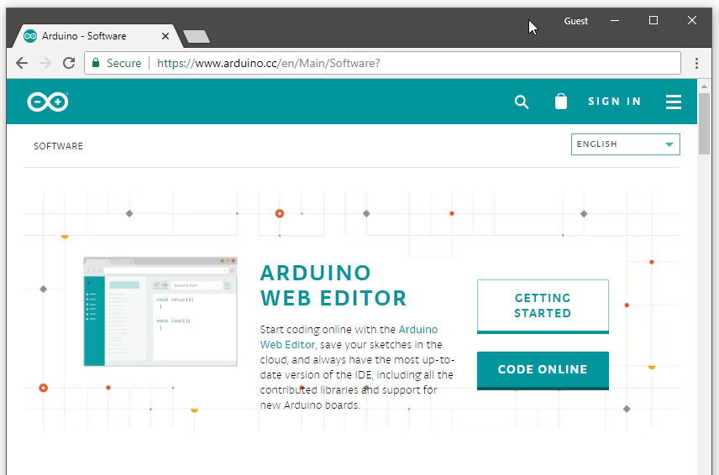
Scroll down and select windows Installer from list

Slide 9

Scroll down and select Just download

Slide 10
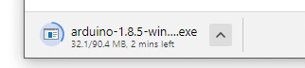
Wait until Download completed

Slide 11
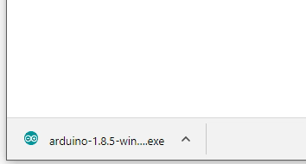
Right click and select show
in folder

Slide 12
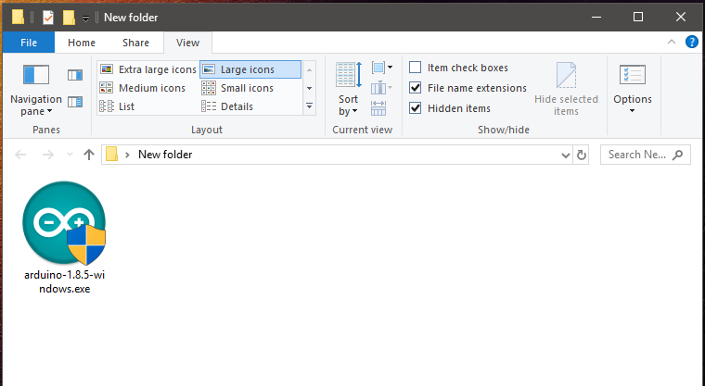
Double click the downloaded file

Slide 13
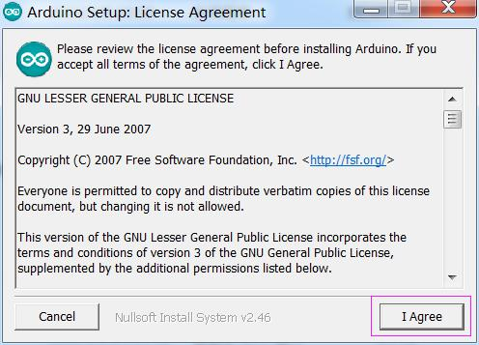
Press I Agree

Slide 14
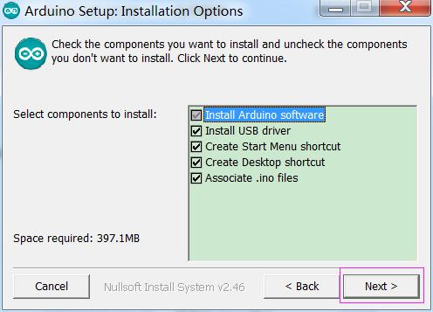
Press Next

Slide 15
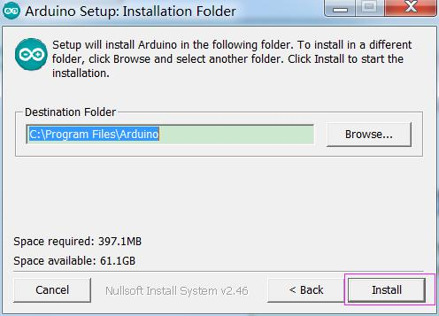
Press Install

Slide 16
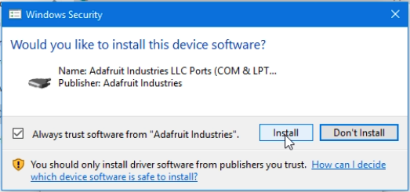
Press Install

Slide 17
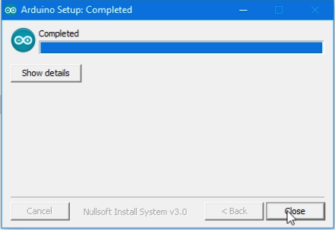
Press Close

Slide 18
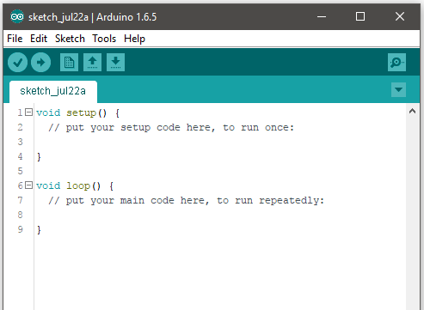
Arduino IDE Overview

Slide 19
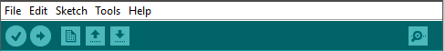
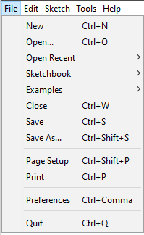
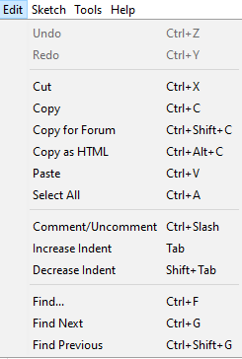
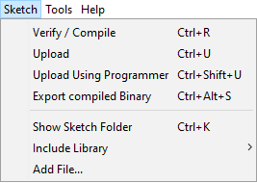
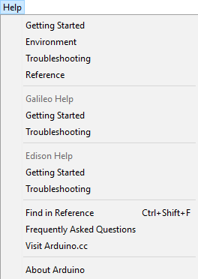
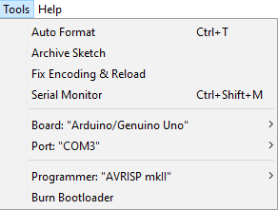

Slide 20






Verify
Ctrl+R
Upload
Ctrl+U
New
Ctrl+N
Open
Ctrl+O
Save
Ctrl+S
Serial Monitor
Ctrl+Shift+M

Slide 21
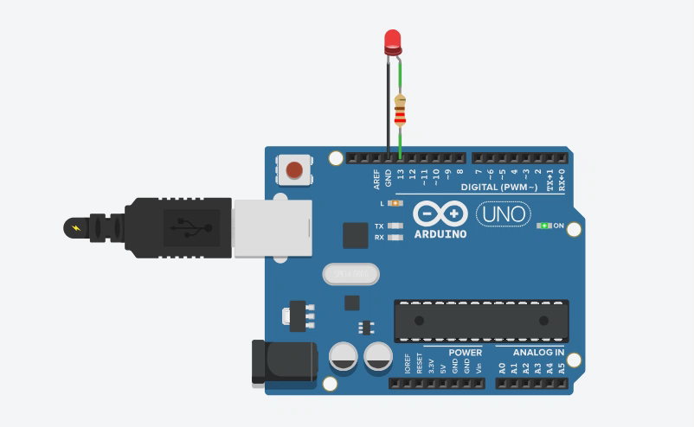
Arduino Blink

Slide 22
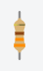

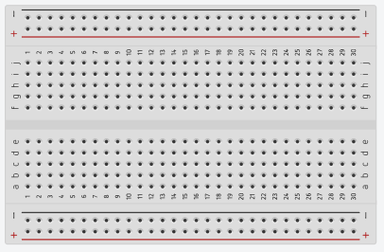
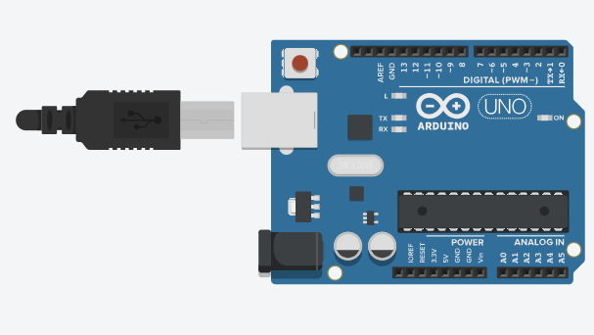
Required Instruments:
Arduino
Breadboard
LED
Resistor

Slide 23
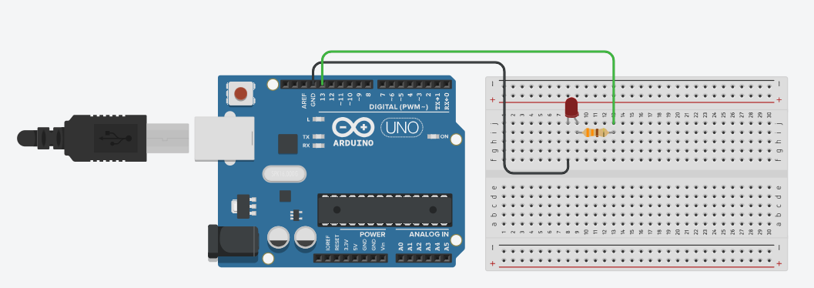
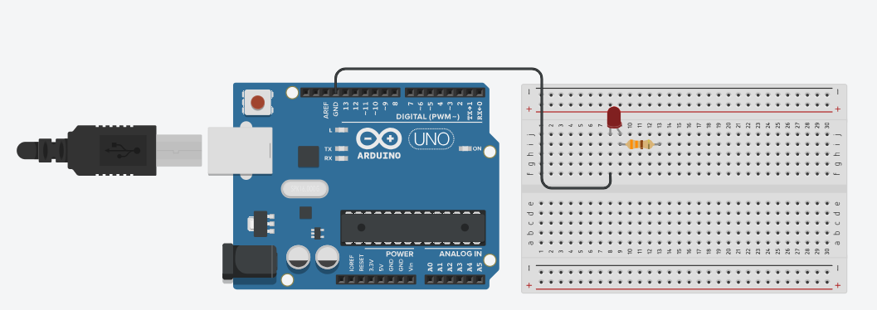
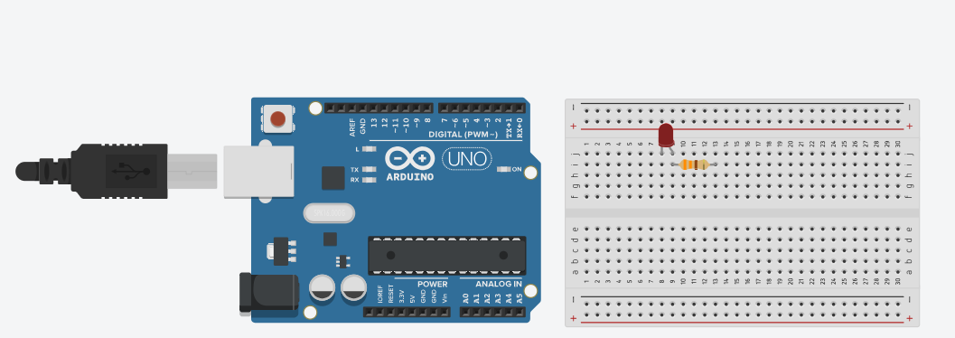
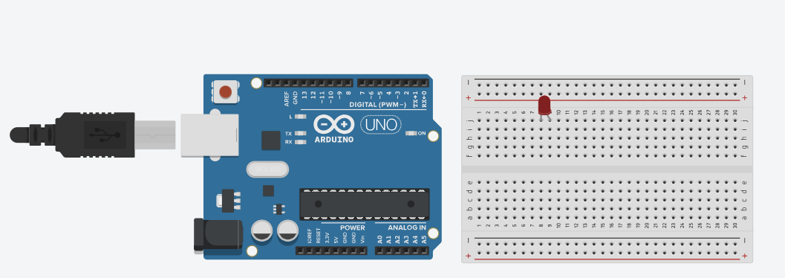
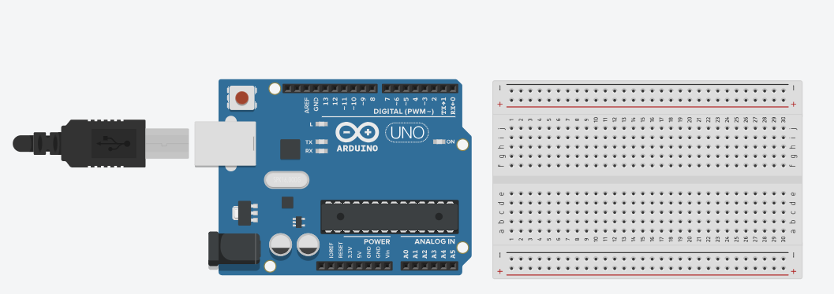

Slide 24
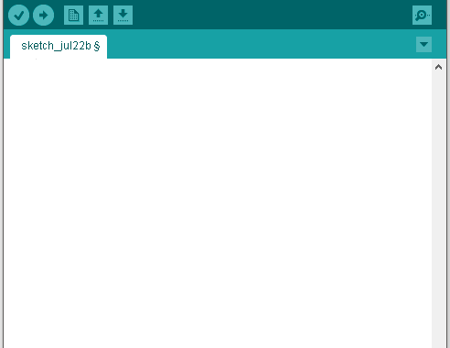
// Setup Function
void setup() {
pinMode(13, OUTPUT);
// Set pin 13 as output
}
// Loop Function
void loop() {
// Turn On LED
digitalWrite(13, HIGH);
delay(1000);
digitalWrite(13, LOW);
delay(1000);
// Wait 1 second
// Turn Off LED
// Wait 1 second
}

Slide 25
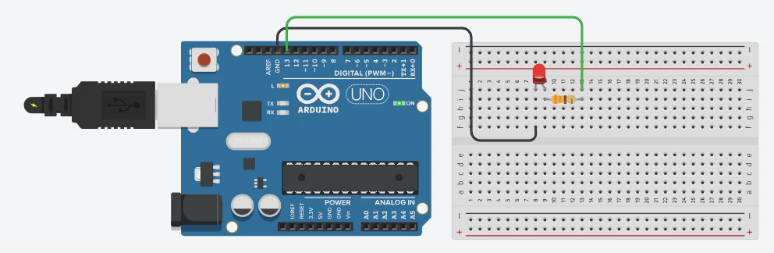

Slide 26
THANK YOU
www.g-robotics.cc
www.fb.com/GRoboticsLTD

